Slide 1
Bidirectional Counter Presentation
AMBIKA_2002220310004
RAHUL RAJ_2002220310016
RAJU KUMAR_2002220310017

Slide 2
Introduction
A bidirectional counter is a counter that can be incremented or decremented. It is commonly used in various applications such as electronics and digital systems.
Counting in Two Directions: Bidirectional counters can increment (count up) as well as decrement (count down) based on the input signals they receive. This flexibility allows them to handle a wide range of applications.
Binary Representation: Like unidirectional counters, bidirectional counters typically use binary representation for counting. They have the ability to add or subtract binary values, enabling both increasing and decreasing sequences.
Controlled by Input Signals: The direction of counting is controlled by specific input signals. For example, a bidirectional counter may have separate input lines for counting up and counting down, allowing external control over the direction of the count.

Slide 3
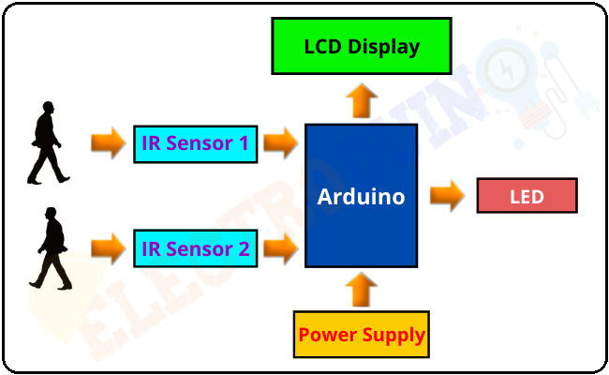
Basic Concept
The bidirectional counter can count both upwards and downwards. It has two modes: counting up and counting down. This flexibility makes it suitable for a wide range of applications.

Slide 4
COMPONENTS USED
Arduino uno: The Arduino Uno is based on the ATmega328P microcontroller, which is the brain of the board (eight inputs, eight outputs)
IR Sensor: An IR sensor, also known as an infrared sensor, is a device that detects infrared radiation in its surroundings.
LCD: Liquid Crystal Display, is a flat-panel technology that uses liquid crystals sandwiched between two layers of glass or plastic.
I2C: It is a two-wire communication protocol, consisting of a Serial Data Line (SDA) for data transfer and a Serial Clock Line (SCL) for synchronization. I2C allows multiple devices to be connected to the same bus
Bread Board:
Jumper Wire:

Slide 5

ALGORITHM USED
Software: The software component of our bi-directional object detection system leverages Python for image processing and object detection using libraries like OpenCV.

Slide 6
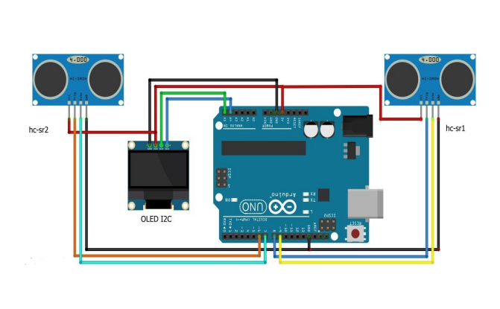
BLOCK DIAGRAM

Slide 7


Applications
1. Bidirectional counters find applications in In Classrooms to keep Track of number of Persons in the room.

Slide 8
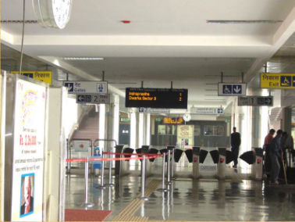
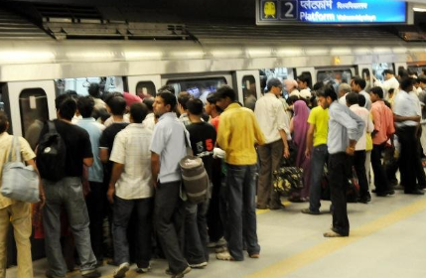
Applications
2. Security Purposes and Keeping Track of Number of People Simultaneously Travelling.

Slide 9
HOW DOES BIDIRECTIONAL VISITOR COUNTER WORK ?
THE BIDIRECTIONAL VISITOR COUNTER WORKS WITH MOST COMMONLY THREE COMPONENTS: SENSOR,CONTROLLER AND COUNTER DISPLAY.
THE SENSOR'S JOB IS TO PROVIDE INPUT TO THE CONTROLLER ABOUT ANY INTERRUPTION OR OBSERVATION AND THEN THE CONTROLLER WOULD RUN THE COUNTER UP OR DOWN DEPENDING UPON THE ACTION AND CHANGES IN THE UP/DOWN MODE DEPENDING ON THE SELECTION MADE ON THE 7 LCD DISPLAY ACCORDINGLY.
IN MOST OF THE MODELS, TWO INFRARED SENSORS MODULES ARE USED FOR UP OR DOWN COUNTING.

Slide 10
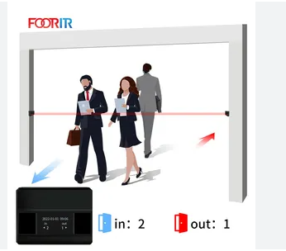
Up Mode
In Up mode, the bidirectional counter increments its count with each clock pulse. It is used when the count needs to increase sequentially.

Slide 11
Down Mode
In Down mode, the bidirectional counter decrements its count with each clock pulse. It is used when the count needs to decrease sequentially.

Slide 12
Advantages
The bidirectional counter offers flexibility, allowing for both increasing and decreasing counts. This feature makes it versatile in various applications where bidirectional counting is required.

Slide 13
Limitations
While bidirectional counters are versatile, they may require additional circuitry for proper control. Careful consideration of the application requirements is essential to ensure optimal performance.

Slide 14
Conclusion
In conclusion, bidirectional counters play a crucial role in digital systems, offering the flexibility of both upward and downward counting. Their applications range from simple electronic circuits to complex control systems.

Slide 15
THANK YOU

